Slide 1
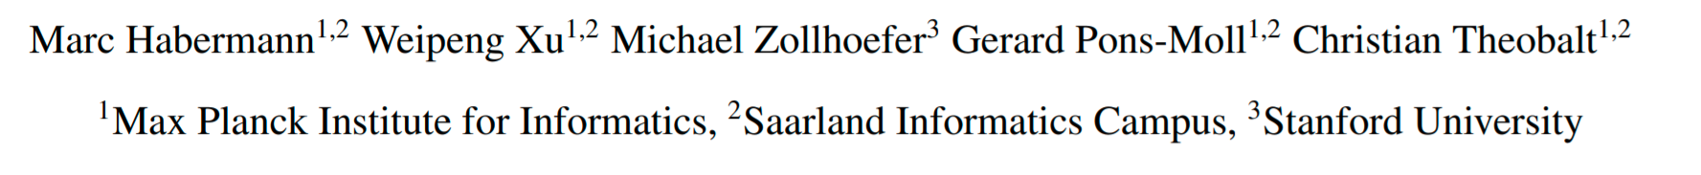
DeepCap: Monocular Human Performance Capture Using Weak Supervision (CVPR 2020)
Wen Liu
2020/9/25

Slide 2
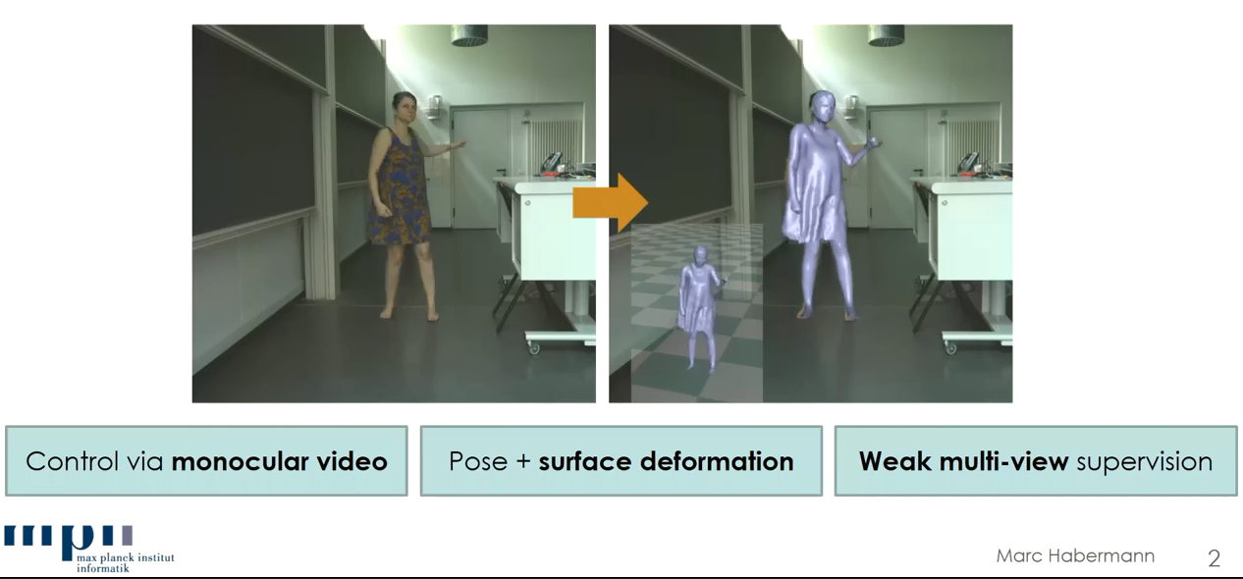
DeepCap

Slide 3
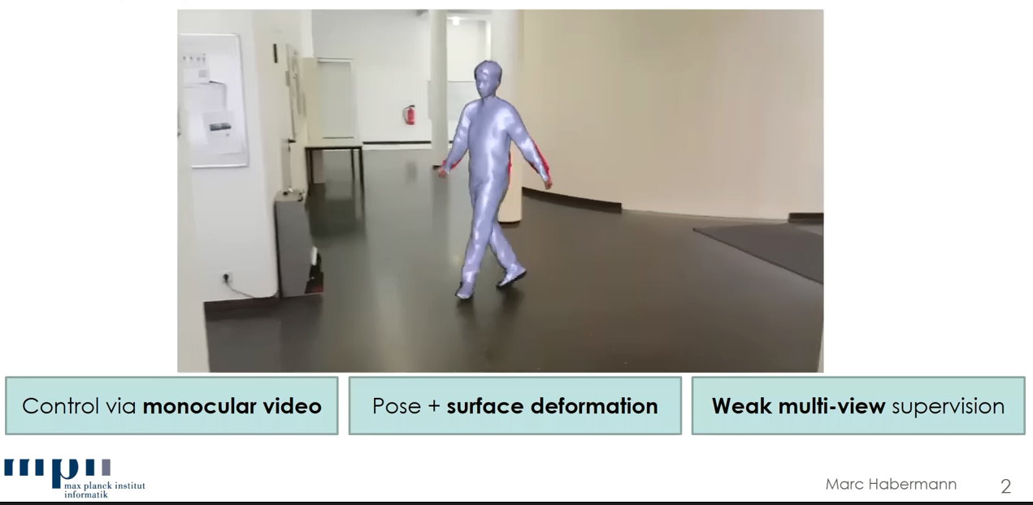
DeepCap

Slide 4
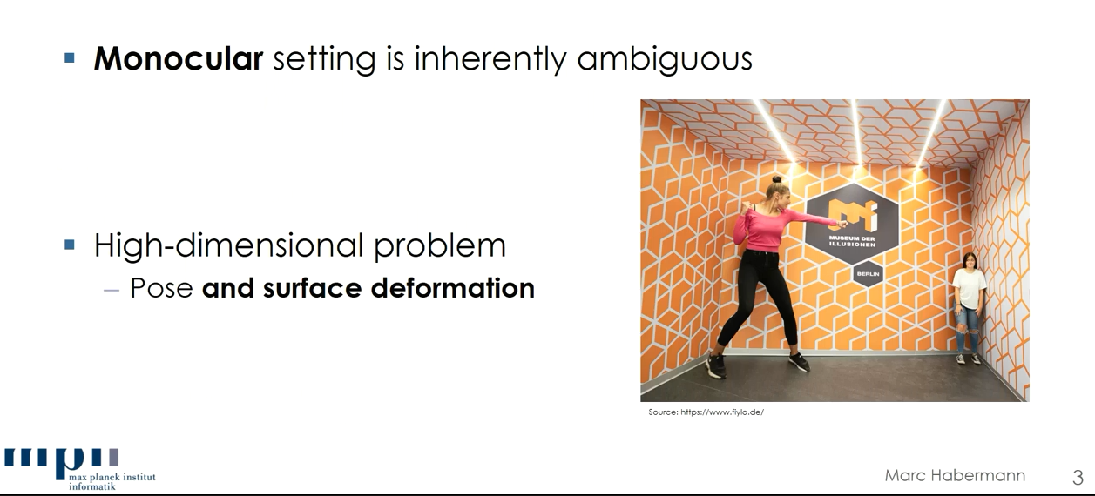
Challenges

Slide 5
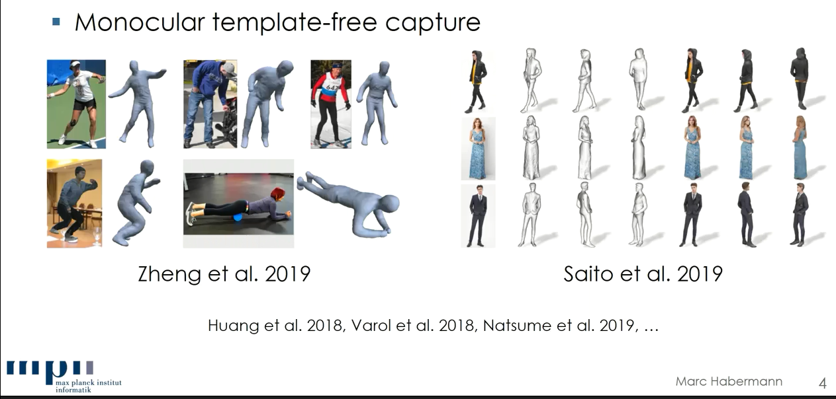
Related Work

Slide 6
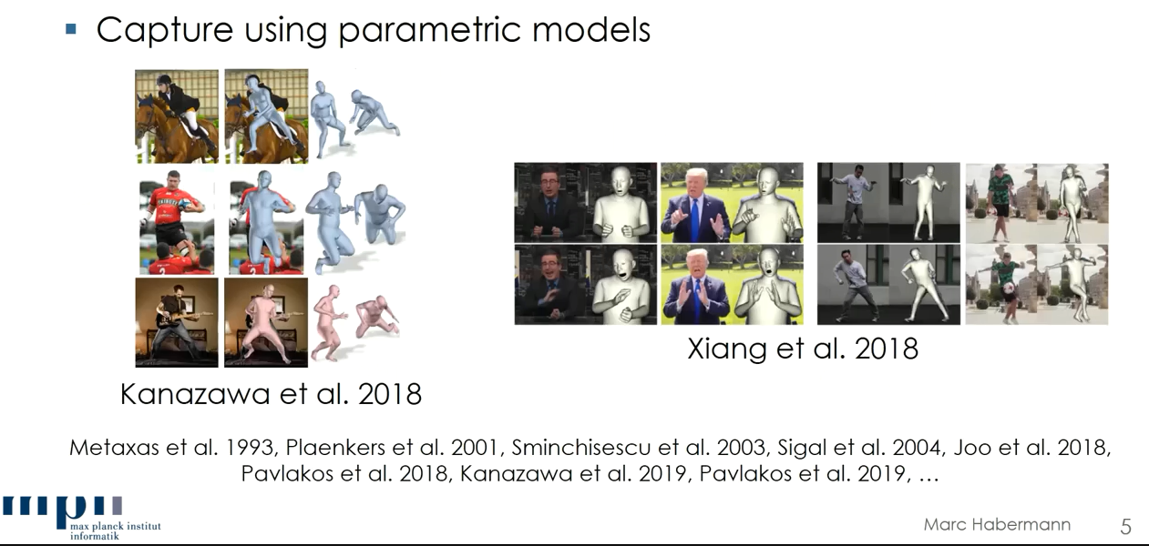
Related Work

Slide 7
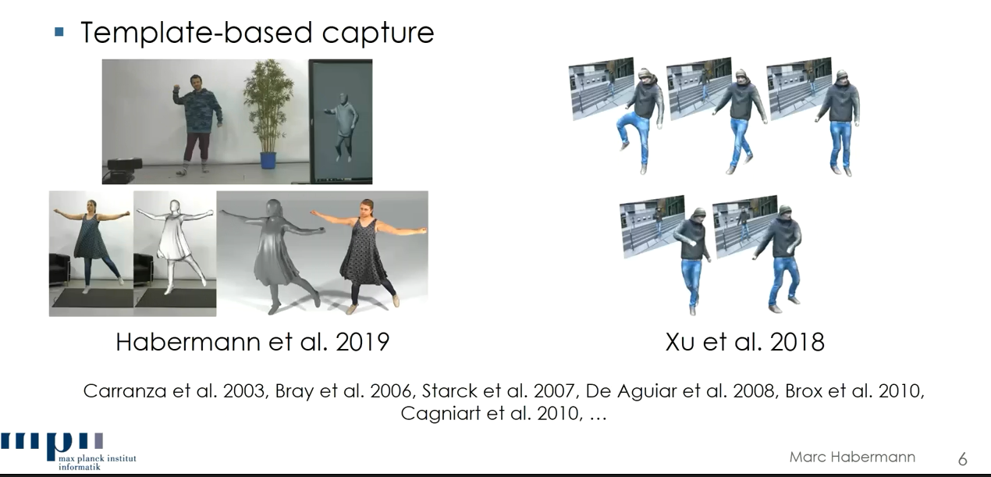
Related Work

Slide 8
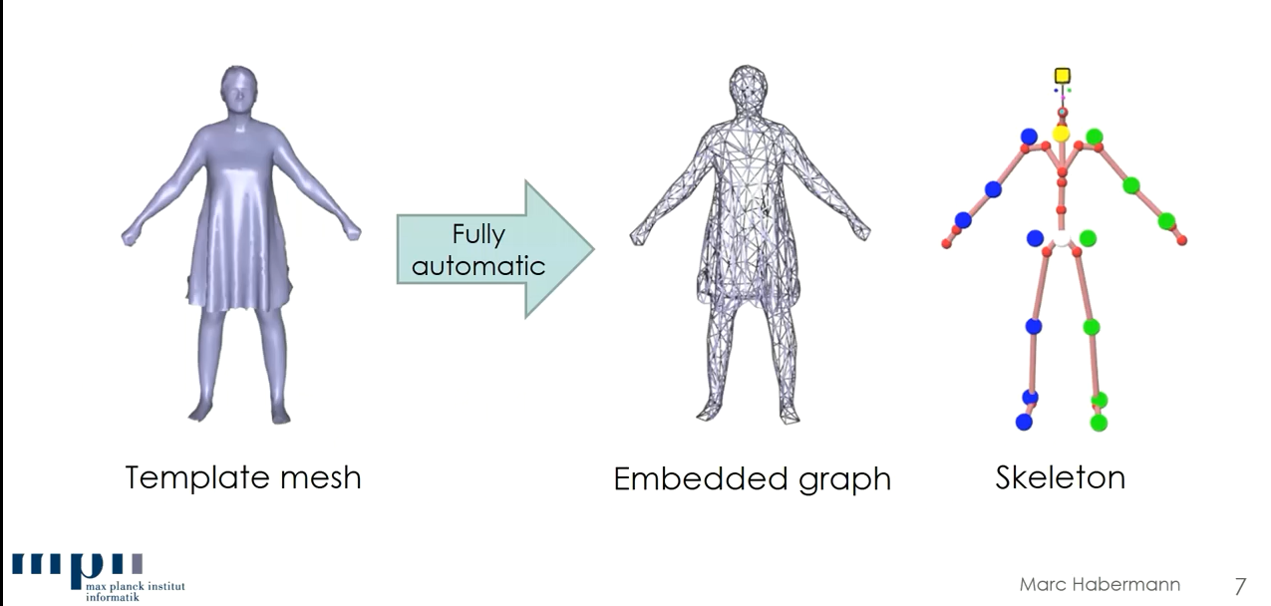
1. Personalized Character Model

Slide 9
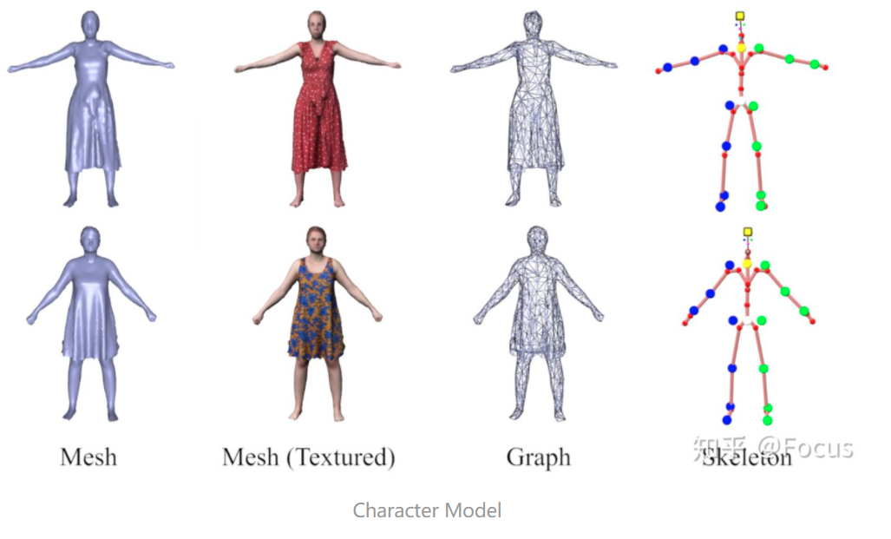
1. Personalized Character Model

Slide 10
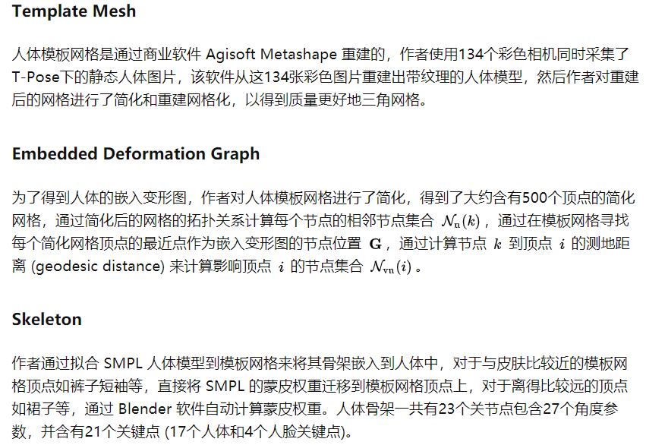
1. Personalized Character Model

Slide 11
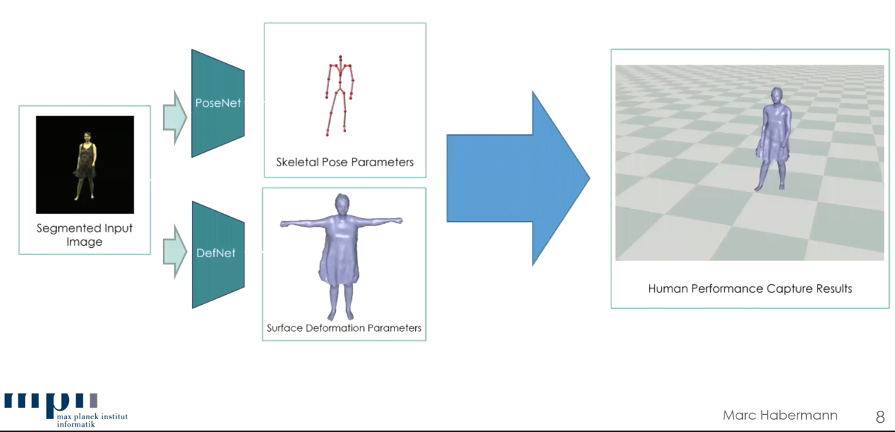
2. Inference Time

Slide 12
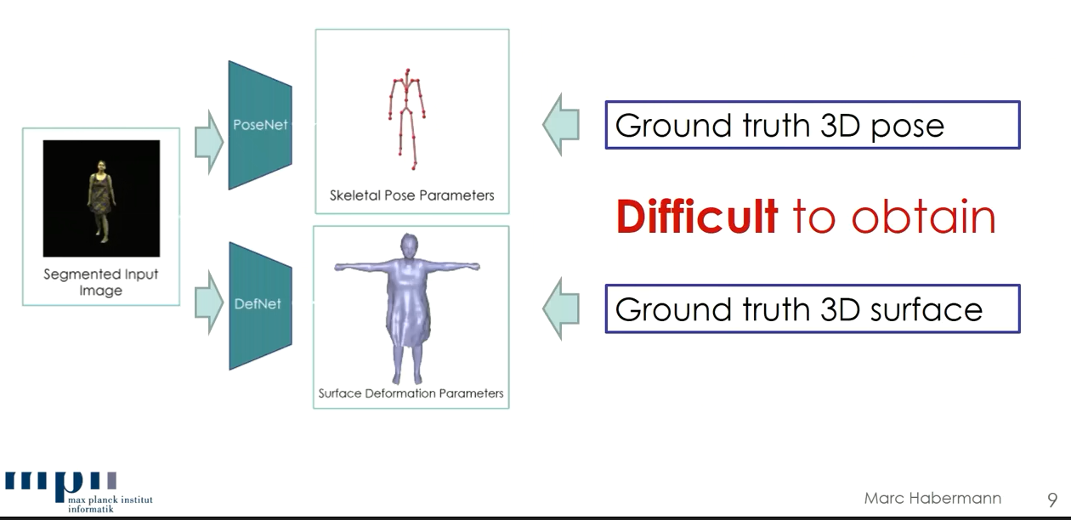
Direct Supervision?

Slide 13
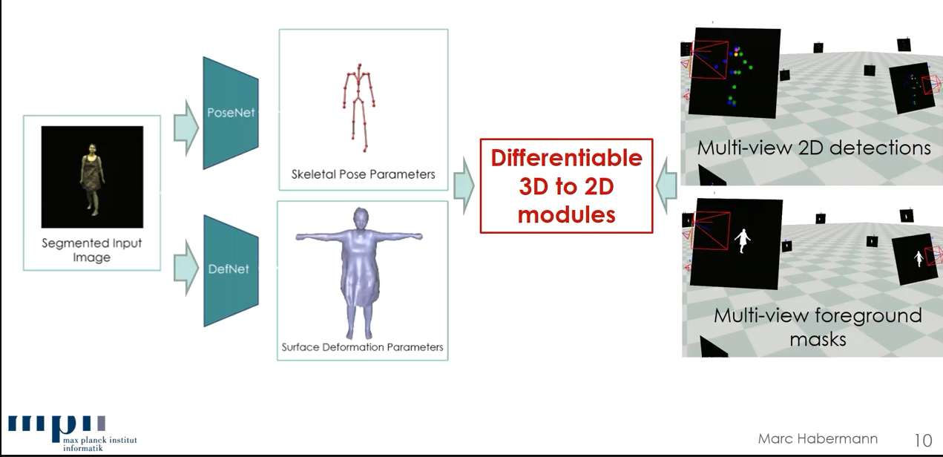
Weak Supervision

Slide 14
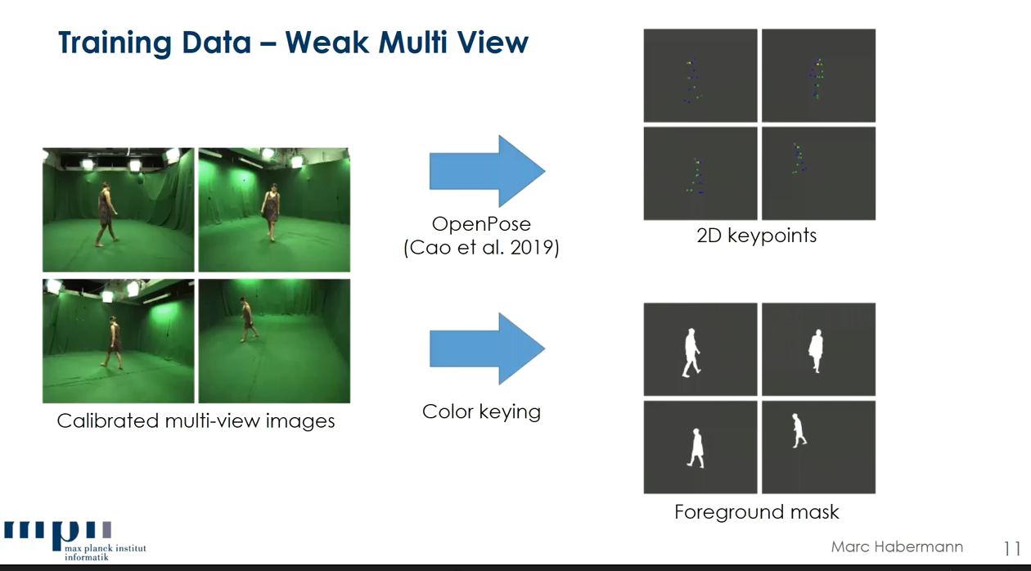

Slide 15
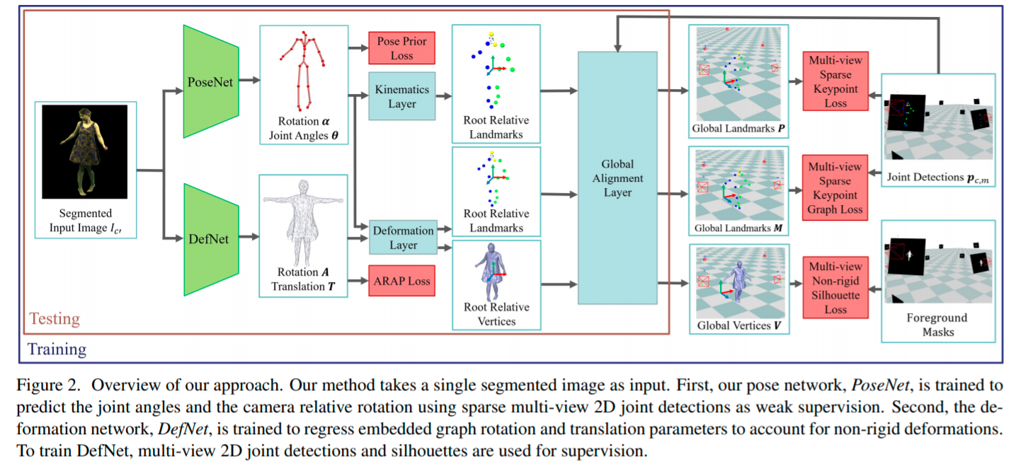
Pipeline

Slide 16
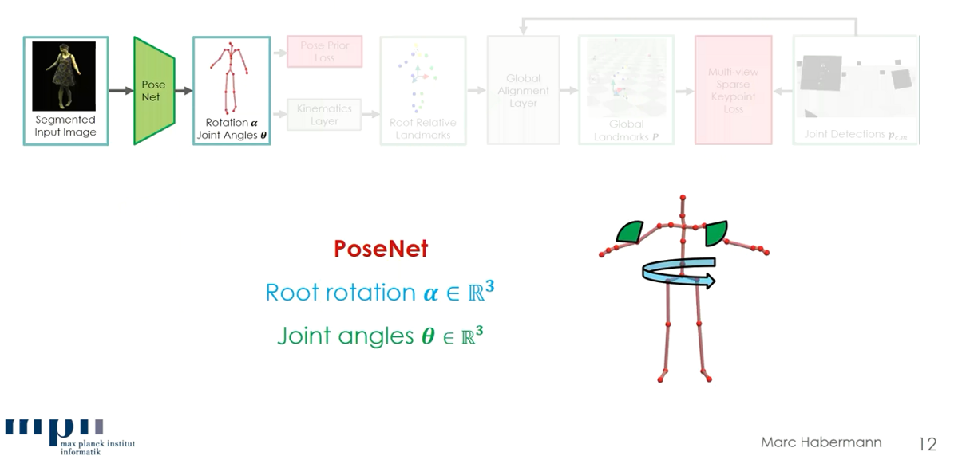
PoseNet

Slide 17
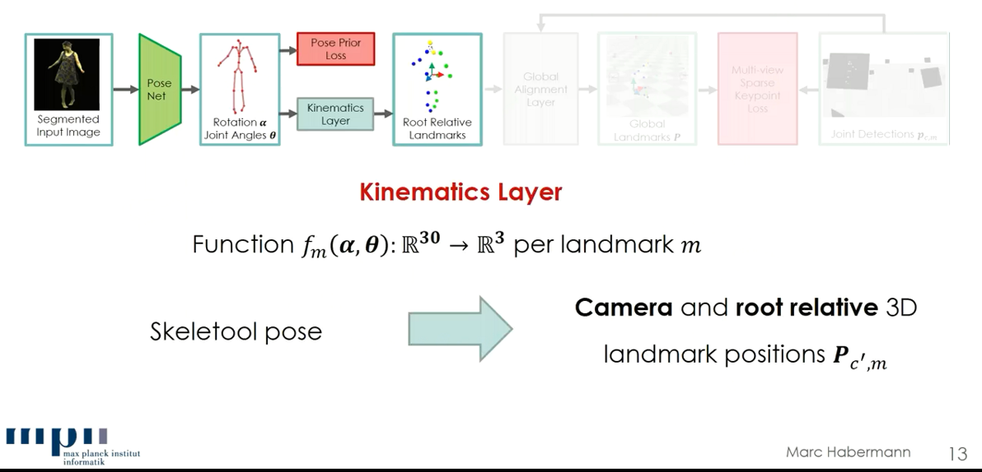
PoseNet

Slide 18
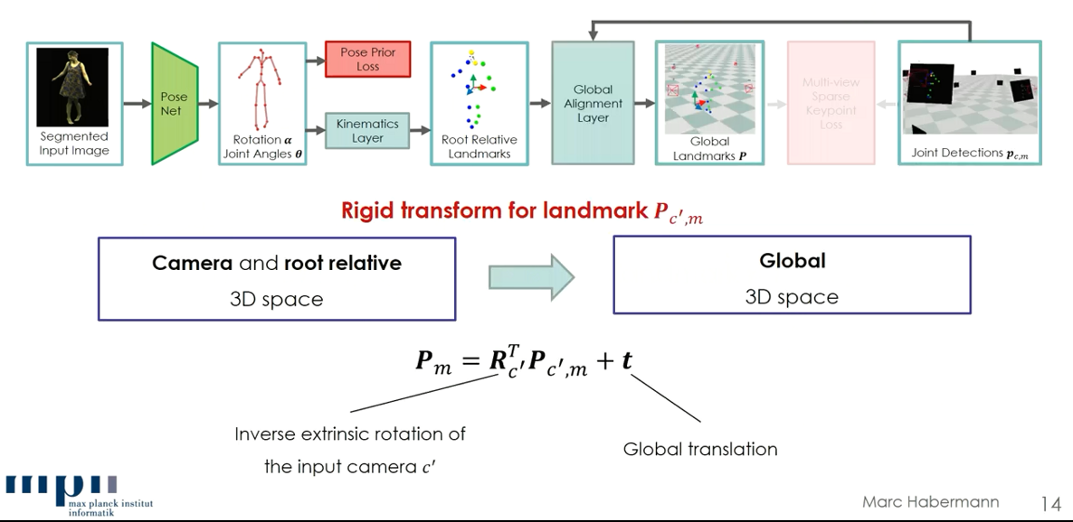
PoseNet

Slide 19
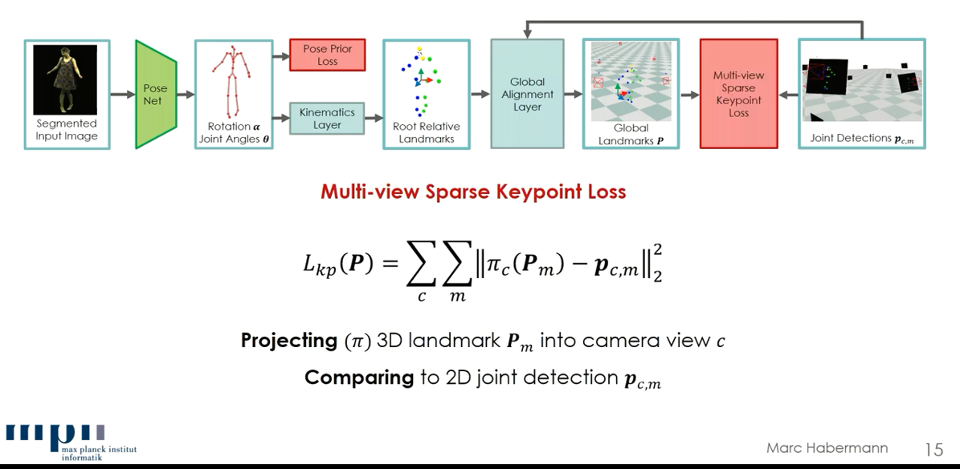
PoseNet: Loss

Slide 20
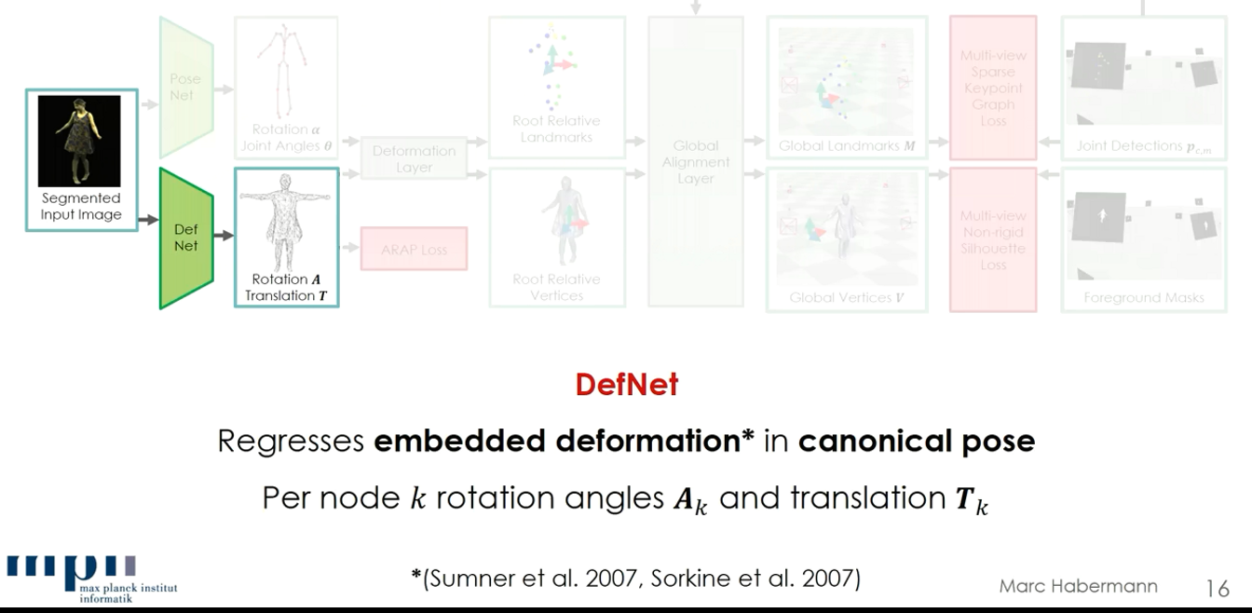
DefNet

Slide 21
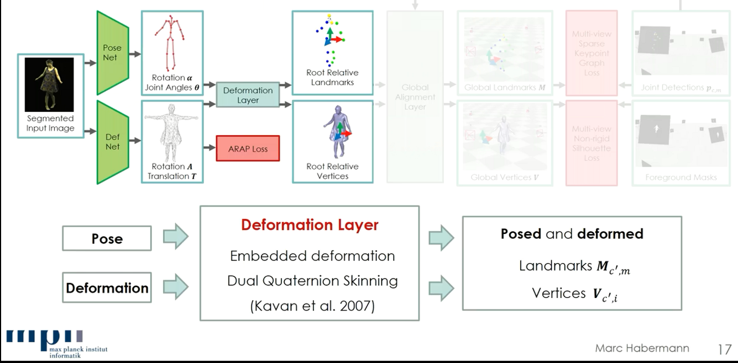
DefNet

Slide 22
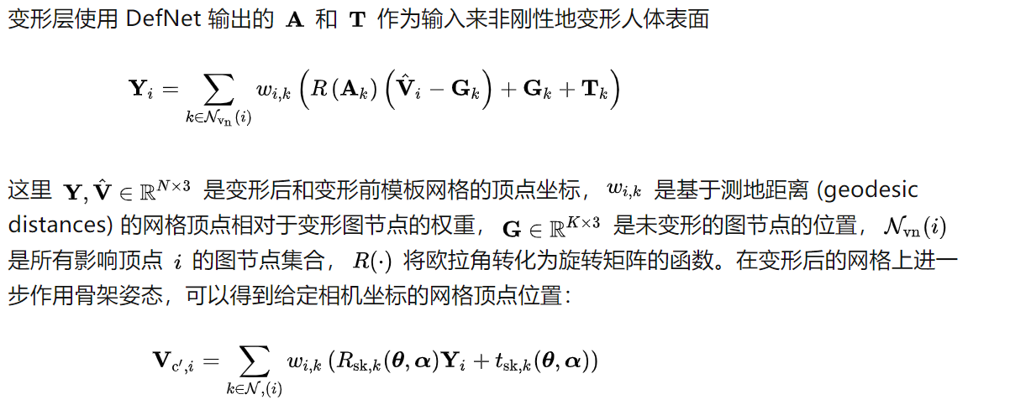
DefNet: Deformation Layer

Slide 23
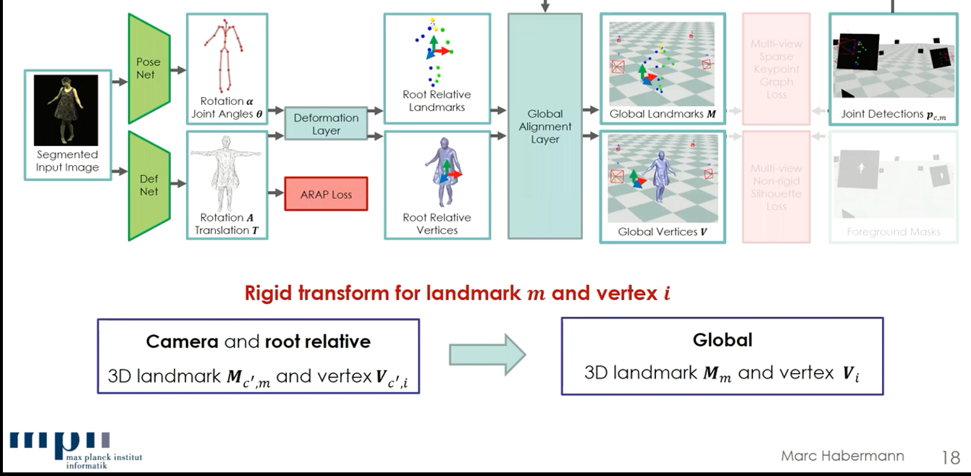
DefNet

Slide 24
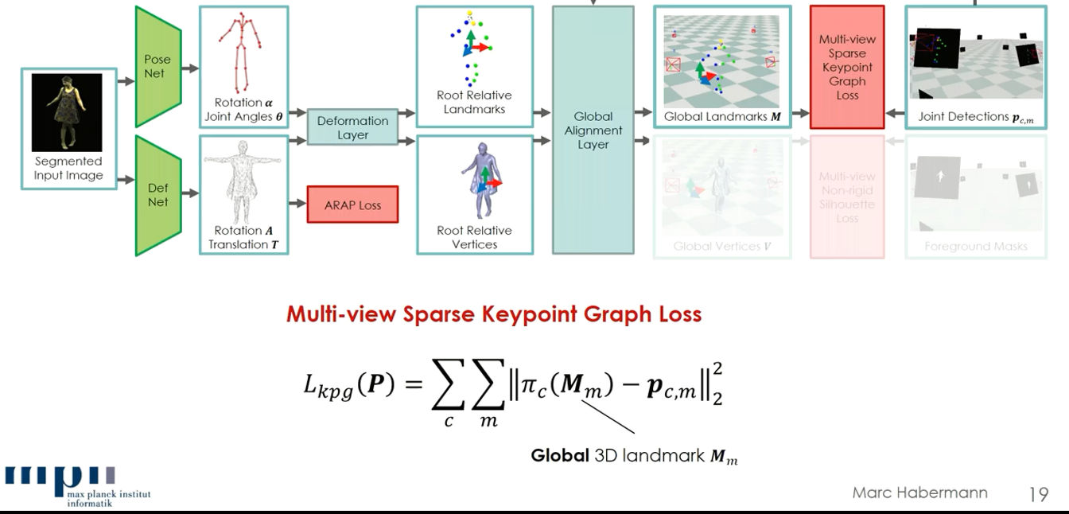
DefNet: Loss

Slide 25
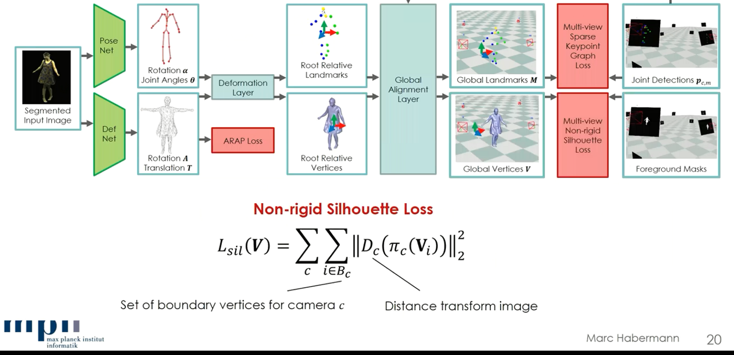
DefNet: Loss

Slide 26
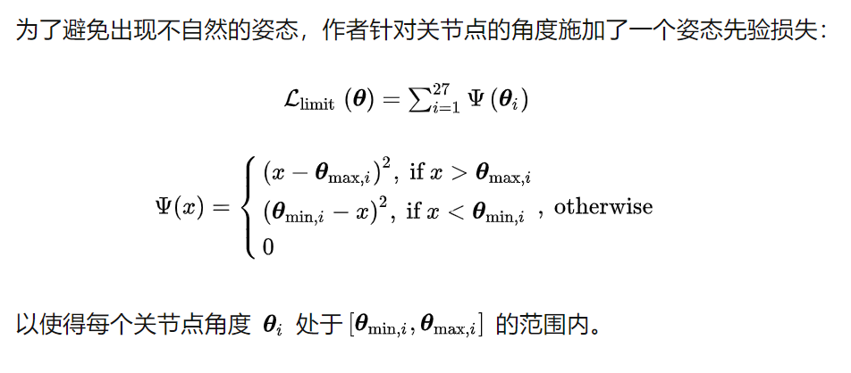
Additional Losses
Pose Prior loss

Slide 27
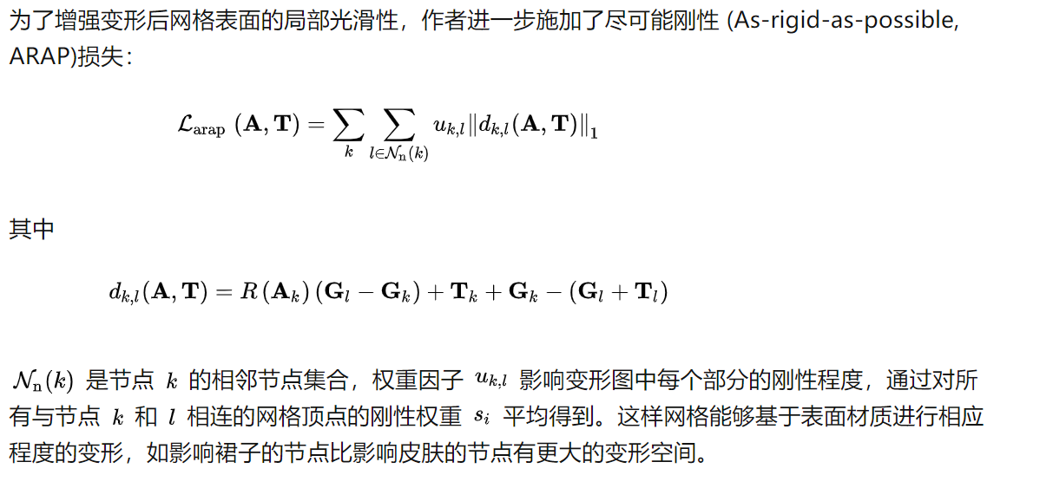
Additional Losses
As-rigid-as-possible-loss (ASAP)

Slide 28
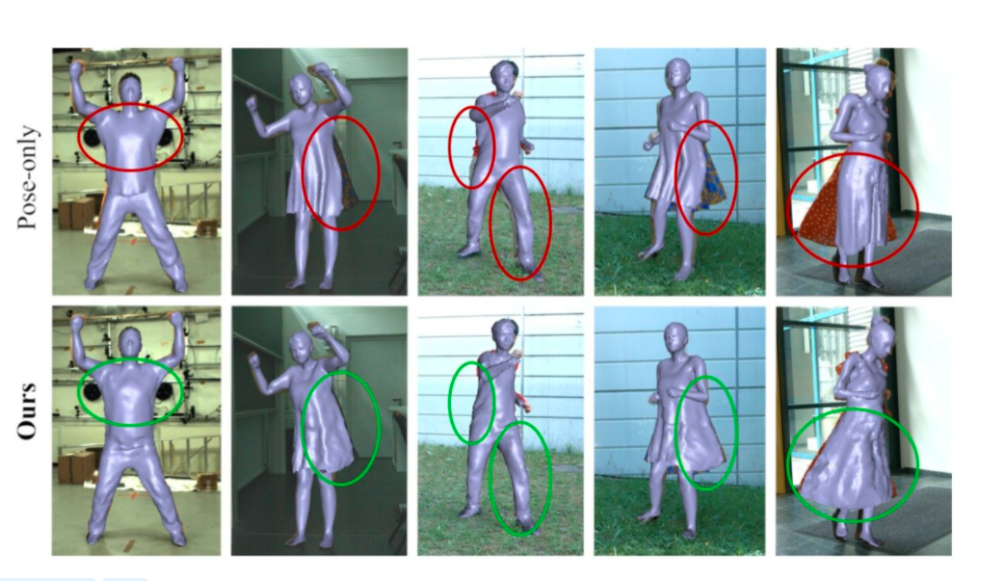
Results

Slide 29
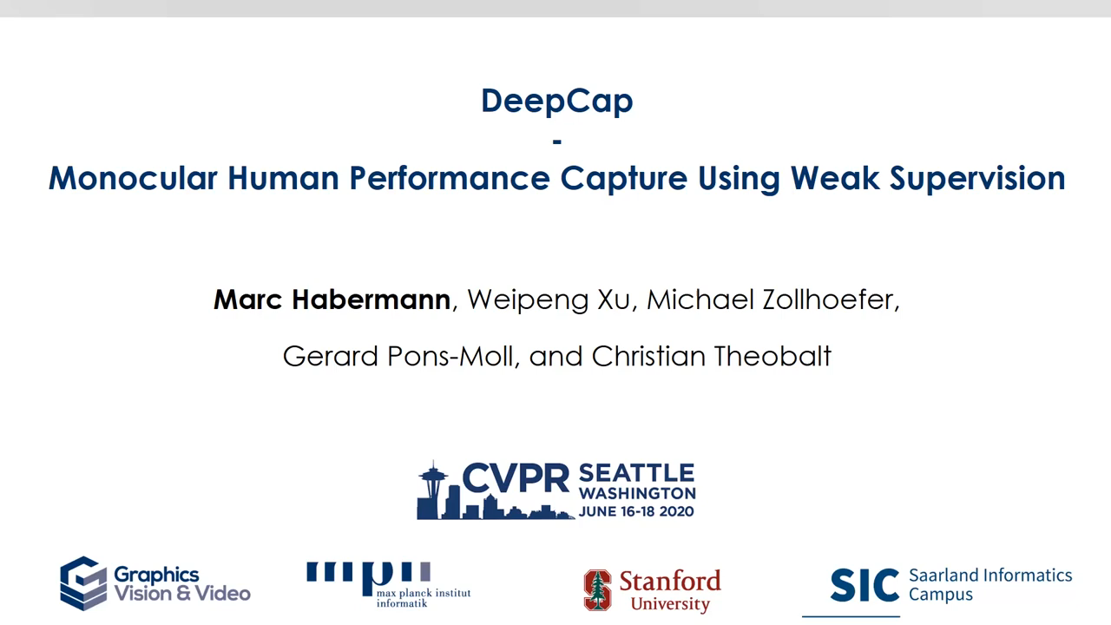
Results

